Slide 1
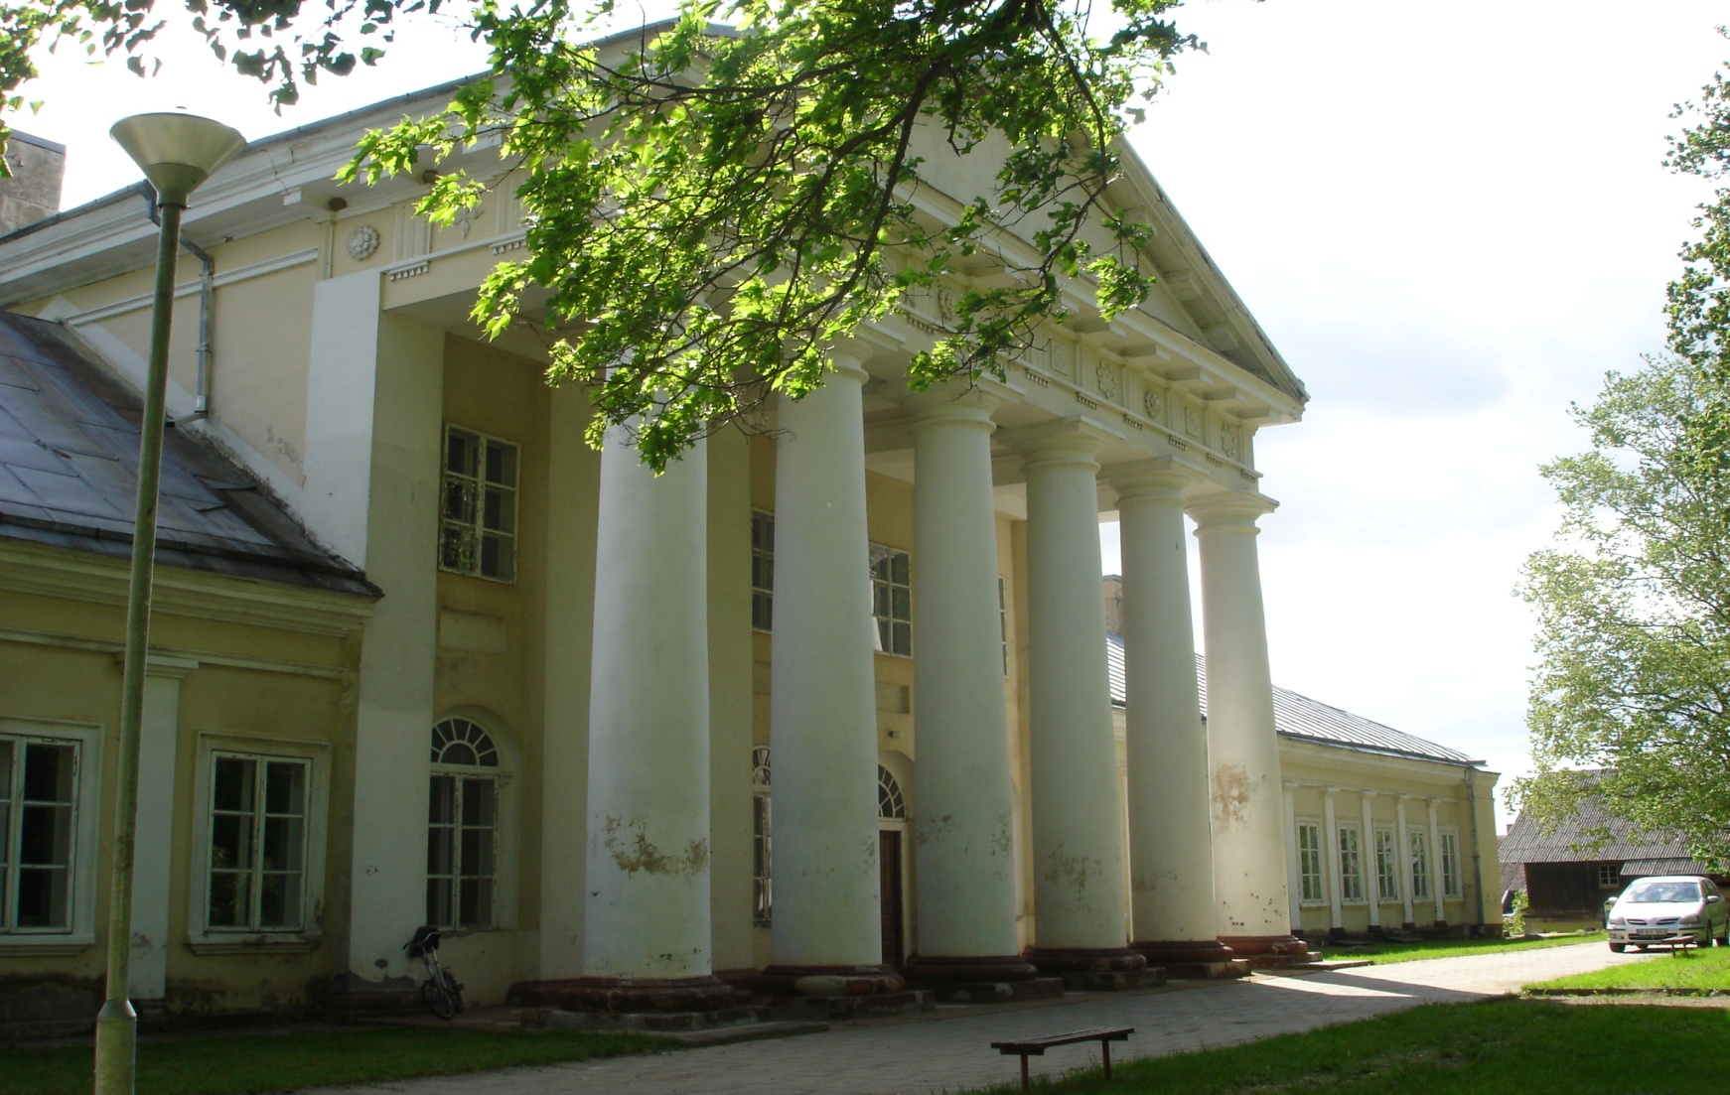
Project “Adjustment of Salos Manour House in Rokiskis region for the needs of cultural tourism”. Total value -3,6 million Eur.

Slide 2
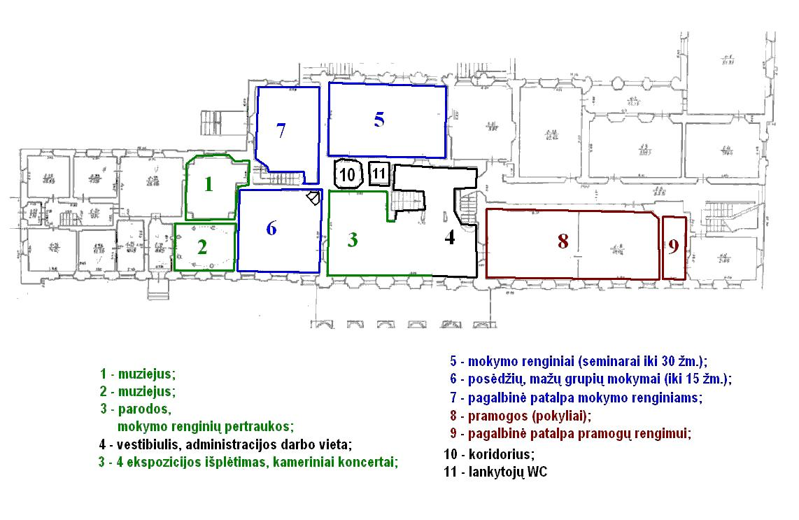
Scheme of premises adjustment

Slide 3
Scheme symbols:
1.Museum
2. Museum
3. Exhibitions, coffee brakes of events
4. Administration premises, lobby
3-4. Exhibition extension, commercial concerts
5. Educational events (workshops for 30 persons)
6. Sessions, small group educational events (for 15 persons)
7.Utility room for educational events
8.Banquets
9.Utility room for entertainment
10. Hall
11. WC

Slide 4
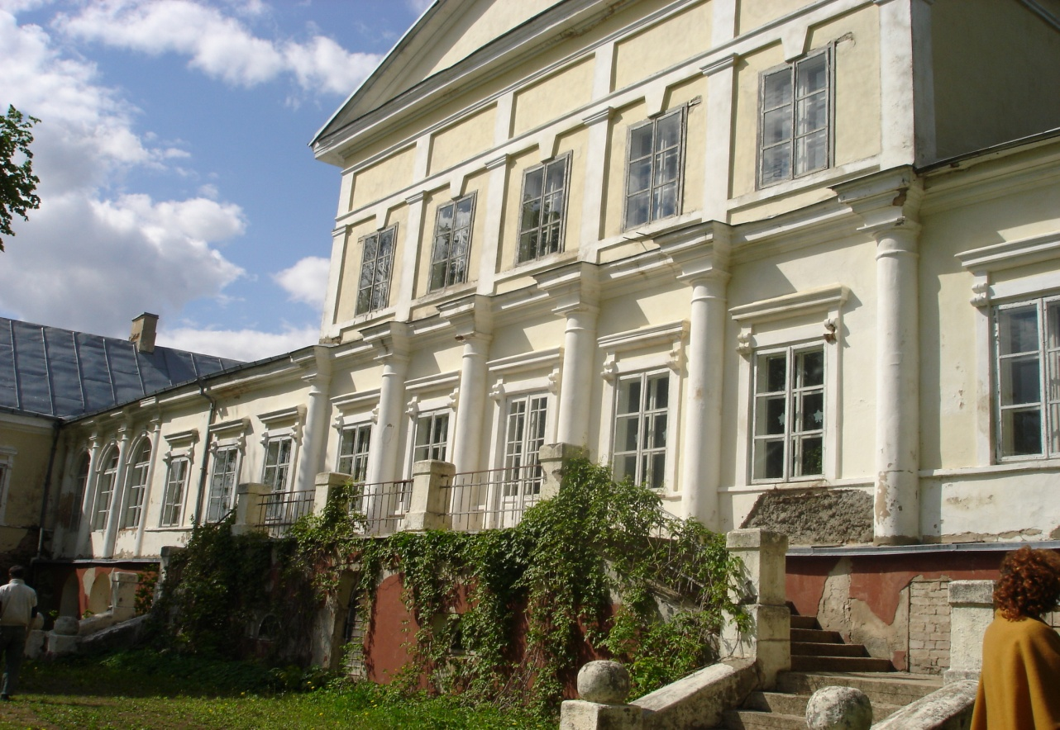
Objective of the project:
Adjustment of non-renovated premises of Salos Manour House in Kamajai neighbourhood, Rokiskis region for the cultural tourism and public tourism infrastructure

Slide 5
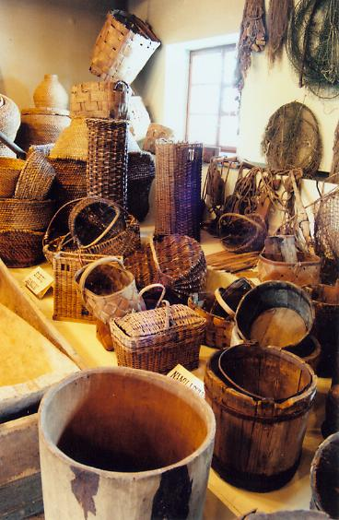
Activities of the project:
► To prepare technical project for non-renovated premises for the needs of tourism;
► To renovate the central part of Salos Manour House which is not renovated (area – 1204,32 square metres);
► To reconstruct and adjust the premises of Salos Manour House for hotel, café, education center, fishing museum, music/crafts school;

Slide 6
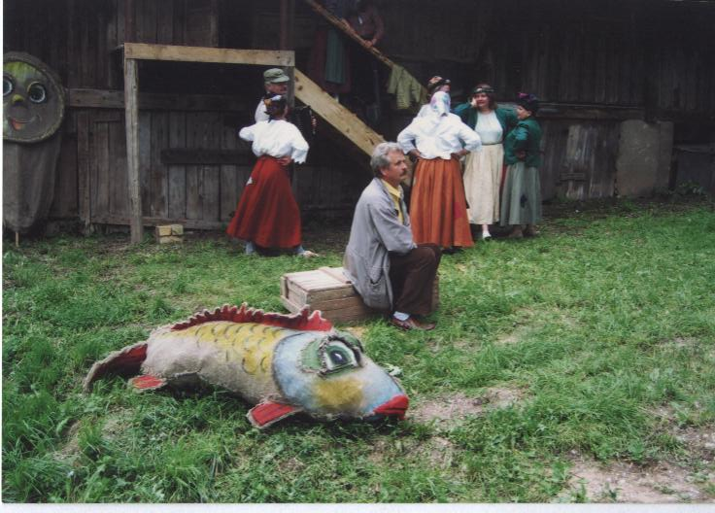
► To purchase furniture and other equipment;
► To install networks and develop environment;
► To prepare educational programmes;
► To prepare new tourism routes about development cultural tourism in Salos Manour House and present them to potential service and information suppliers;
► To publicize the project and organize presentation to the public.

Slide 7
For more detailed information about investment projects of Rokiskis District Municipality please contact:
Rokiskis District Municipality Administration Department of Strategic Planning and Investments
Respublikos str. 94, LT-42136 Rokiškis
phone.: 8 458 71407
email: verslas@post.rokiskis.lt
v.meciukoniene@post.rokiskis.lt

